Slide 1

E-Care Ecosystem: Online Medical Advice and Drug Controlling Application
INFO 5100 : Application Engineering and Development FINAL PROJECT
Submitted By : Ankit Bhayani

Slide 2
The Problem
The Medical Services have improved to a great extent over the last few decades, but the flow of critical patient information and other procedures are fairly slow given the limited reliance on computers for the same.
Patients have to wait for days after making an appointment to actually see the doctor.
Travel long distances for consultation.
Go to the medical store and wait in line to purchase the drugs on the prescription.
Patients use drugs out of their own discretion without taking the trouble of the process, which causes other side effects.
It takes a long time for the information about the negative effects to reach the relevant people who play an important role in regulating the usage of the drugs.

Slide 3
The proposed Solution
All these problems needs to be addressed through a software “application” where patient can have the following facilities:
Send his/her Vital Signs Online by using Smart Device.
Get a preliminary prescription from the doctor online
Get the prescribed medicines delivered at home by the pharmacy.
View his/her past drug orders.
Schedule the appointment for later visits.
Send feedback to drug manufacturers and Drug Administration Authority to review the drugs and share such information

Slide 4
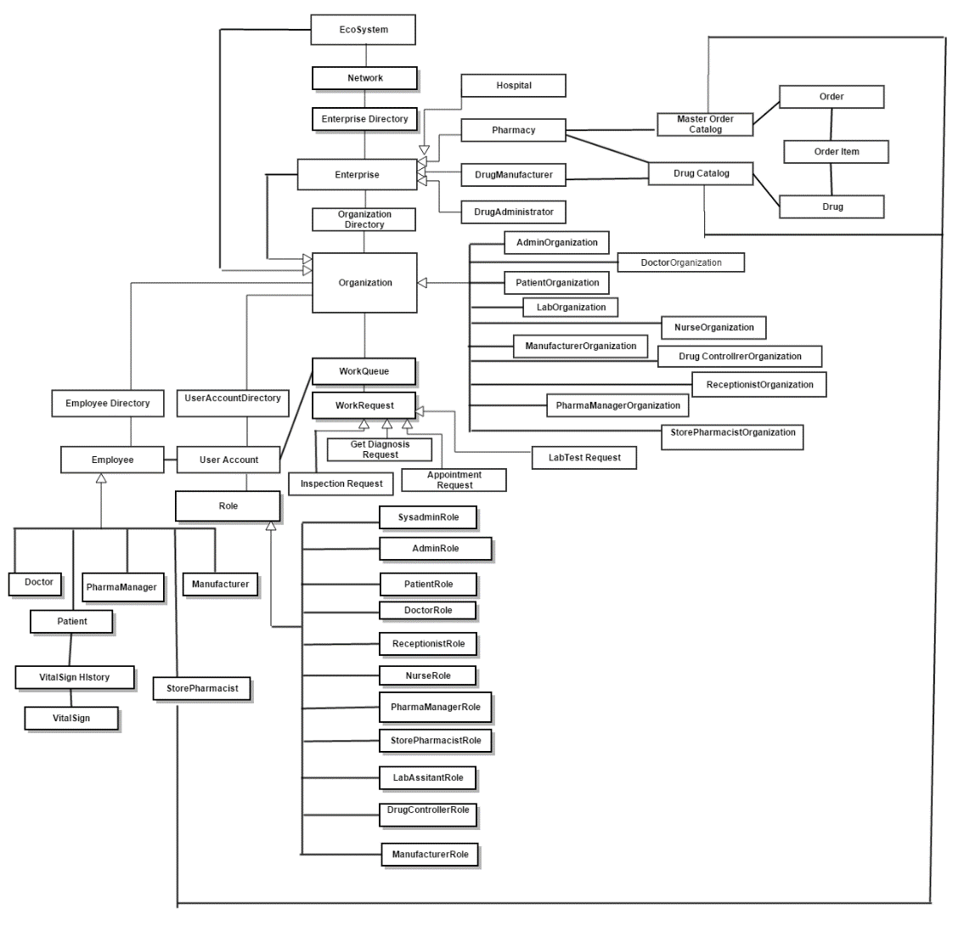
Object Model

Slide 5
Key Roles
Patient
Doctor
Receptionist
Nurse
Lab Assistant
Pharma Manager
Store Pharmacist
Manufacturer
Drug Controller
Enterprise Administrator

Slide 6
Key Features
The patient can search for the physicians/doctors available in a particular city.
The patient can register and send details of his/her symptoms, past medications and vital signs to his selected physician/doctor.
The patient can get preliminary prescription online.
The patient is able to schedule an appointment with the doctor for later visit.
The physician/doctor can check the cases and appointments on the dashboard.

Slide 7
Key Features
The physician can give diagnosis based on symptoms and prescribe medicines.
The doctor would be able to extract the past medical history in graphical report format.
The physician can send the prescription to the pharmacist for a particular patient.
The system allows pharmacist to deliver prescribed drugs to the patient at home.
Pharmacist can check inventory for the reports for the drug released for a certain period for a particular patient.

Slide 8
Extra IOT Features
- Capturing Vital Signs From Smart Device.
- Patients having identical health problems would be able to view the graphical representation of each other’s health condition over a given timespan, which might be useful to take insight to rectify the medical problems faced.

Slide 9
API’s included
Google Static Map
Java Mail
Itext Reports
Jcalender/Date Chooser
JFreeCharts
JDOM
DB40 implementation

Slide 10
Thank You!!

Slide 11

Questions

